Slide 1
Engineers rule the world
Fahmida Rahman
Shraddha Sagar

Slide 2
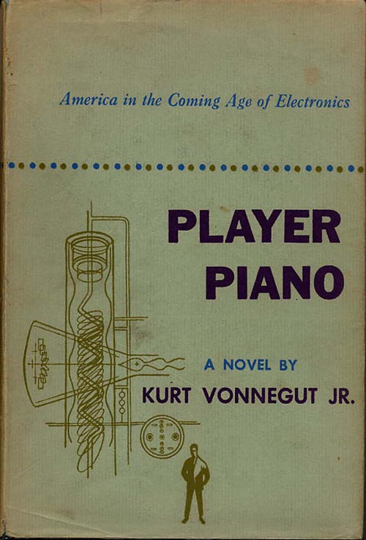
The Story

Slide 3


Slide 4
Current Scenario
Human error accounts for more than 90% of car crashes
American drivers spend about 293 hours on average behind the wheel annually*
17 hours a year searching for parking spots**
Automation of Driving
Huge societal benefit : reduce accidents, liberate elders and the disabled
Notes:
*AAA Foundation of Traffic Safety
**USA Today

Slide 5
AVs - Transformation in the Economy
Increase in Productivity
Influx of new jobs
Reduction in prices of goods
More space
Notes:
http://www.businessinsider.com/how-driverless-cars-will-change-the-economy-2016-5

Slide 6
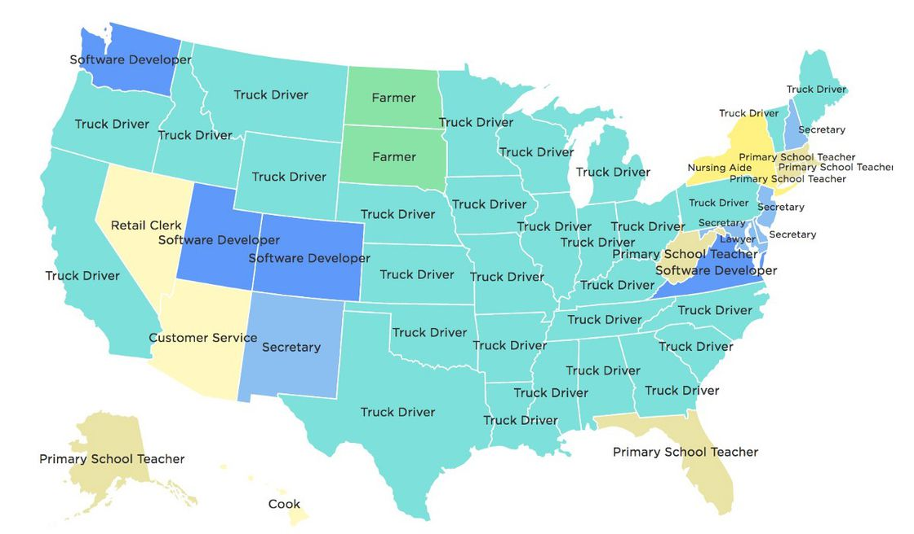
Autonomous Vehicles - Who will be affected
Parking
Real Estate
Law Enforcement
Insurance
Hotels
Truck industry
Notes:
https://www.cnbc.com/2017/05/03/self-driving-cars-will-disrupt-10-industries-commentary.html
https://www.recode.net/2017/4/19/15364608/autonomous-self-driving-cars-impact-disruption-society-mobility

Slide 7
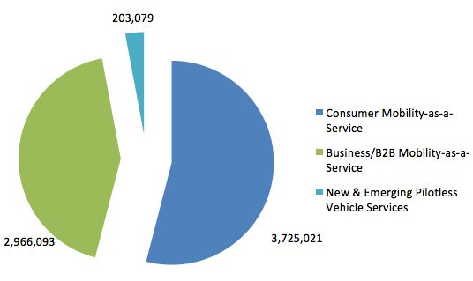
Economic Effects of AVs
Figure: Global service revenue generated by autonomous driving in 2050 (US$ millions)
Notes:
https://voxeu.org/article/potential-economic-and-social-effects-driverless-cars

Slide 8

Positive Aspects on Economy
Albeit private ownership of cars reduces dramatically, the overall automotive market will likely expand as the vehicle distance travelled (VDT)
The trucking and freight industry improves transport efficiency.
Enable trucking companies to transport larger quantities of freight at lower costs, resulting in an increase in economic benefits.
Decrease in congestion pricing
Approximately $488 billion of cost savings through a reduction in injuries and deaths caused by car collisions.
The overall economic effects of autonomous vehicles, which combine both industry-specific and economy-wide effects, amount to more than $1.2 trillion, or $3,800 per capita.
Notes:
https://voxeu.org/article/potential-economic-and-social-effects-driverless-cars

Slide 9
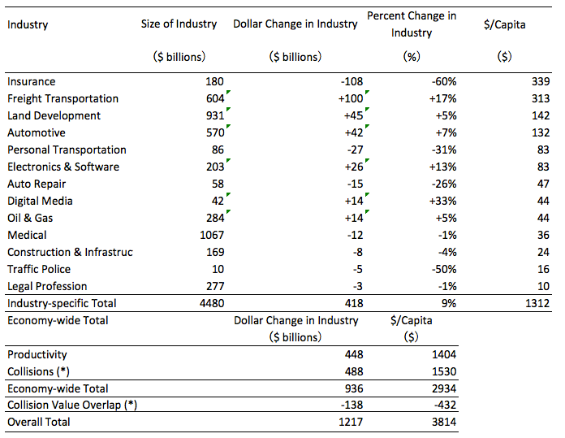
Summary of Economic Effects (Industry- and Economy-Wide)
Source: Clements and Kockelman (2017).
Notes:
https://voxeu.org/article/potential-economic-and-social-effects-driverless-cars

Slide 10
AVs vs Public Health, Safety and Society
Reduce accidents from human error
Liberate elders and the disabled
Eliminate the need for auto insurance policies.
Demand for car repair services, medical services, and traffic police will decrease.
More space for the community
Less noise, better environment
Notes:
https://voxeu.org/article/potential-economic-and-social-effects-driverless-cars
https://www.youtube.com/watch?v=mrNZYEdGA5Q

Slide 11
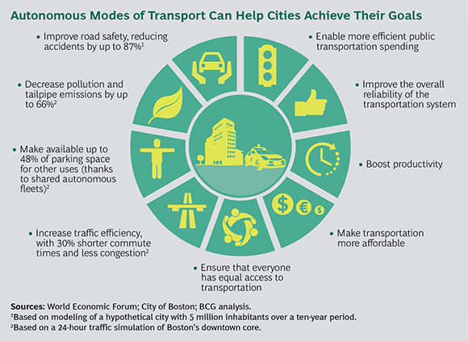
At a glance: How AVs interact with our economy and society
Notes:
https://www.bcg.com/publications/2017/automotive-making-autonomous-vehicles-a-reality.aspx

Slide 12
AVs interacts with The Transportation System
-Decrease in road accidents and congestion results in improved efficiency .
-Improved efficiency in the use of roadways translates into increased roadway capacity.
-Requires less space than conventional cars and no signs or signals required .
-Reduction in the need for car parking spaces.
-People will be able to use car-sharing services whenever necessary.
Notes:
https://www.youtube.com/watch?v=mrNZYEdGA5Q
https://voxeu.org/article/potential-economic-and-social-effects-driverless-cars

Slide 13
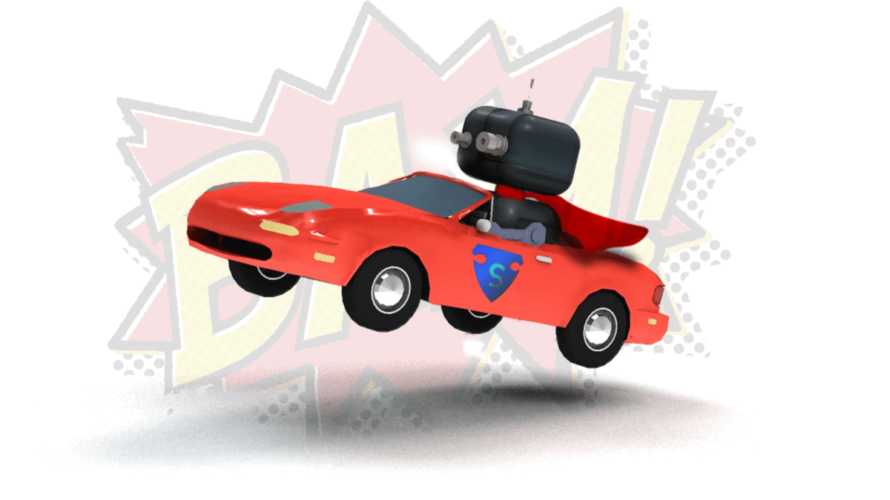
Steps/Questions before promoting AVs
What sort of transportation system should we build when fully automated vehicles become the norm?
How should we change urban landscape including land use and how should we redesign the economic and social systems?
What will be the road infrastructure?
How people will be made comfortable about the new changes?
Notes:
https://voxeu.org/article/potential-economic-and-social-effects-driverless-cars

Slide 14
QUESTIONS..

